Slide 1
Case title: Putting shared decision making into practice

Slide 2
General notes and guidance
Overview: This case study aims to educate learners on how they can implement a shared decision-making (SDM) approach with their patients, using a patient with advanced HER2 mutation-positive NSCLC as an example. The case study should address some of the common barriers and pitfalls that clinicians may make when engaging in a SDM approach.
Learning objectives:
Explain the importance of shared decision making (SDM) in the context of biomarker testing and targeted therapies.
Recognize common patient concerns and questions regarding biomarker testing and targeted therapies and develop strategies to manage them.
Evaluate and discuss biomarker test results and treatment options with patients, considering their values and preferences.
Format: Please populate this template with the content requested on each slide, adding figures and imagery where appropriate. This template serves to act as a guide, therefore please add any additional slides/content that you feel is relevant. Springer Healthcare IME will develop these slides into a storyboard for you to review. We will film supportive short clips of you to provide learners with more information at key decision points.
Desired length: 15 minutes
References: Please include citations and references where appropriate.
Example of past case study: https://ckd-management-pcp.ime.springerhealthcare.com/en/module/ckd-with-t2d-and-cvd/
Additional notes: Avoid mentioning treatment brand names where possible and pharmaceutical company names in isolation.

Slide 3
Disclosures
Consulting/advisory fees from Eli Lilly, EMD Serono (Merck KGaA), AstraZeneca, Spectrum Pharmaceutics, Novartis, Regeneron, Boehringer Ingelheim, Hengrui Therapeutics, Bayer, Teligene, Taiho, Daiichi Sankyo, Janssen, Blueprint Medicines, Sensei Biotherapeutics, SystImmune, ArriVent, Abion, BlossomHill, and Abbvie
Research Funding to Institution from Eli Lilly, EMD Serono, ArriVent, Dizal, Teligene, Regeneron, Janssen, ThermoFisher, Takeda, and Boehringer Ingelheim
Travel Support from EMD Serono, Janssen, and Spectrum Pharmaceutics

Slide 4
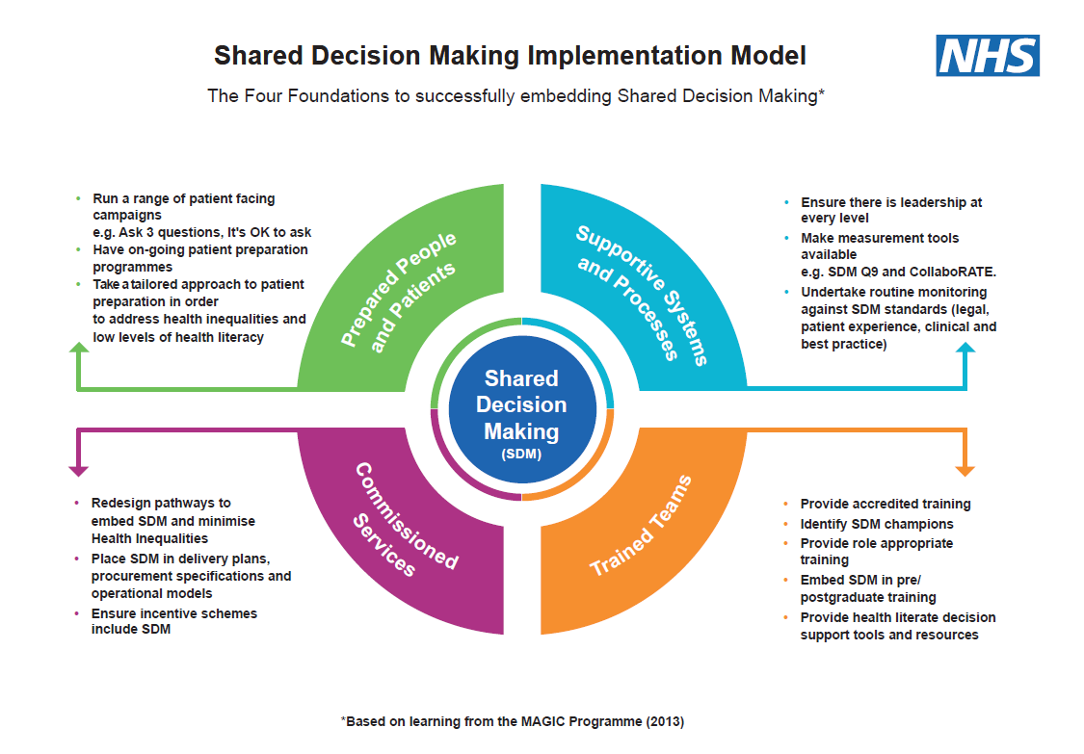
Introduction
https://www.england.nhs.uk/personalisedcare/shared-decision-making/
Shared decision making (SDM) is a collaborative process where a patient and their healthcare provider work together to make health care decisions. SDM is based on the patient's values and preferences, the provider's expertise, and the best available scientific evidence.
SDM can help patients:
Be fully informed about all care options and their potential benefits and harms
Make individualized care decisions
Feel supported in making decisions

Slide 5
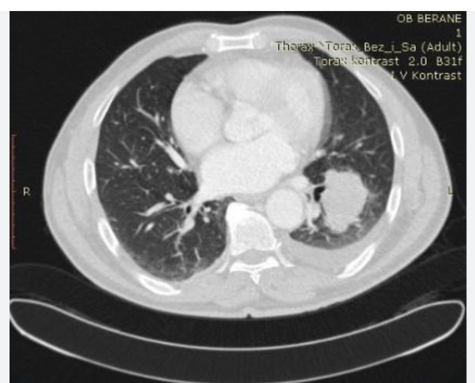
Case profile
Basic case information | 55 years old female Working as a system engineer
Medical history | Hypertension
Medications | Lisinopril low dose
Family history | Father CAD, mother HTN and DM, no significant cancer history
Lifestyle | Never smoked cigarette
Clinical characteristics | Presented with pneumonia, not responding to antibiotics.
Relevant test results | CXR showed persistent LLL lung mass with possible pleural effusions
CT chest showed lung mass with pleural effusion

Slide 6
Assessment question 1
What is the next steps of diagnostic workup (please select all)
PET scan and brain MRI
Thoracentesis for cytology
Tumor biopsy
NGS testing and PDL1 IHC in the tumor samples
ctDNA in peripheral blood
All need to be done
How to discuss the rationale for each workup and set patient expectations?
How to discuss the importance of NGS testing in current era of treating lung cancer?

Slide 7
Content: How to ensure SDM throughout the biomarker testing process
Notes for author:
Please expand on the bullet points on this page by elaborating on how HCPs can improve communication when discussing biomarker testing with patients. For example, for the third point you could include guidance like:
- Explain to the patient how the procedure will work and what to expect
- Make sure the patient is aware that it may be necessary to have more than one procedure
The goal here is to provide actionable guidance to HCPs about how they can improve patient communication when conducting biomarker testing. These bullet points are just to start the discussion – they need to be elaborated on to provide guidance on exactly how clinicians can effectively convey this information.
The content doesn’t need to fit on this page – please feel free to add additional slides and images
(2) How to explain what biomarker testing is to patients
NSCLC treatment selection based on characteristics of tumor; physicians must know histology, genetic biomarkers (muts/fusions), as well as immunooncol biomarkers. Once integrated, can make personalized treatment plan for tumor characteristics
Helping patients understand the importance of testing
Same as above
Addressing concerns about biopsies
Help to establish diagnosis
Different histologies – biopsies tell us this for appropriate chemo
Provide tissue for mol testing; required for diagnostics and further work up – not sdm
(3) Set expectation for timing of each work up procedure, especially NGS testing
NGS definition; allows evaluation of hundreds of genes at one time; providing genetic information needed for treatment plan – new technology but needs 2-3 weeks to gather report. Info is crucial to formulate treatment plan, most guidelines recommend waiting for treatment for personalized treatment for each patient
(4) Common patient concerns/questions about biomarker testing and how to address them – other than testing for mutations, we also test blood for genetic testing (liquid biopsy), usually quicker turnaround time for report, not as comprehensive as NGS tissue testing; usually both done for newly diagnosed pateints to accelerate decision making. Times that patients medical condition quickly declines not allowing us to wait 3-4 weeks; in this situation discuss benefits and risks, potentially start chemo without biomarker analysis. Needs to be discussed with patients and family.

Slide 8
Case follow up 1
PET scan and brain MRI
PET scan showed FDG-avid lung mass with associated hilar and mediastinal lymphadenopathy
Brain MRI showed NO CNS metastasis
Thoracentesis for cytology
Malignant cells present in the pleural effusion
Tumor biopsy
Biopsy showed adenocarcinoma, CK7+, TTF-1+, p40-
PDL1 2%
ctDNA in peripheral blood
No detection of any mutations
NGS testing pending (after one of biopsy)

Slide 9
Assessment question 2
Patient feels overall well at the baseline, but very anxious to start treatment
What do you tell the patient and how to make the SDM
Start carbo/pem/pem now
Start carbo/pem without pembro
Wait for tissue NGS results

Slide 10
Content: discussion of test results and evaluating treatment options
Notes for author:
Please expand on the bullet points on this page by elaborating on how HCPs can improve communication with patients when discussing test results and evaluating treatment options. For example, for the last bullet you could include:
Be prepared to answer questions that patients have about the future, e.g., what if this therapy stops working?
Inform patients that everyone’s reactions and experiences will differ
The content doesn’t need to fit on this page – please feel free to add additional slides and images
Explaining biopsy results to patients
Biopsy shows adenocarcinoma = most common type; can occur in patients who have smoking history/don’t. imaging study indicates stage 4 lung cancer and systemic therapy needed.
(3) Importance of discussing the pros and cons of each therapy
mNSCLC with HER2 mut the current front line is plat based chemo +/- immunotherapy. Targeted drug (ADC) is approved after patients tumor has progressed. Currently new oral medications are being developed, not yet approved (TKI) – ongoing studies comparing these with chemo. Discuss clin trial if appropriate.
(2) Explaining NGS results
In this particular tumor testing, alteration (HER2) discovered. This alteration occurred in the area that is functional for HER2 (driver oncogene). HER2 mutation is recosgnized – we have targeted therapies for tumors with this mut. In NGS report TP53 (tumor sup gene – no targeted therapy, new drugs being developed in near future).
Considering patient values/preferences
How to set expectations and reach a mutual decision on the treatment plan and waiting time frame

Slide 11
Case follow up 2
One week later
NGS testing showed HER2 Y772_775 YVMA insertion mutation and TP53 mutation
How to discuss and explain the results to patients?
Explaining test results to patients
Importance of discussing the molecularly-guided selection of therapies

Slide 12
Assessment question 3
Notes for author: please create an assessment question with at least 3 multiple choice options. This should relate to our patient case.
If you have all the following options, what will you recommend to the patient
Carbo/pem/pem
Carbo/pem without pembro
Trastuzumab-deruxtecan
Participation of a phase 3 first-line anti-HER2 TKI clinical trial with randomization
(This TKI has shown good clinical efficacy and safety in phase I studies)
5. Participation of a phase I trial with a novel agent in dose escalation phase
How to reach a treatment decision?
When clinical trials are available, we need to have a discussion for SDM. Clinical trials are human experiments to evaluate new drugs to see if they are better than SOC. Benefits and risks must be understood by patients/families. Benefit = patient can receive treatmetns that are potentially better than ecisting treatments. However risks are that newer drugs have gaps in understanding of toxicity, drug not better than current treatment. Patient + family must know that not all patients are eligible for treatment trials – ALL criteria must be met. Clin trial participantion can be withdrawn at any point. Conpliance to trial scheduele important.
Decision on receiving standard-of-care vs. clinical trial
Decision on phase 3 vs. phase 2 vs. phase 1 trials
Expectation for clinical trial participation
How to handle unknown space?
For trials, sometimes, both toxicities and efficacies are not fully known with ample amount of data

Slide 13
Content: Considerations for monitoring and follow up
Notes for author: please provide information about SDM during the monitoring and follow up process. Content for discussion could include:
Side effect management
Modifying the treatment plan based on patient response and preferences
How to ensure adherence to therapy
Please could you elaborate on the points above – for example, what advice do you have for clinicians on how to communicate side effects (e.g., Make sure that the patient knows how and when to report serious side effects). The content doesn’t need to fit on this page – please feel free to add additional slides and images
Decision on receiving standard-of-care vs. clinical trial
Decision on phase 3 vs. phase 2 vs. phase 1 trials
Expectation for clinical trial participation

Slide 14
Summary
Notes for author: please provide a summary of key points from the case study in bullet point format. These should reflect the most important considerations for clinicians in practice.
Why shared decision making (SDM) is important
Shared decision-making (SDM) puts patients at the center of the decision-making process, considering their preferences, values, and personal circumstances.
Patients and clinicians can develop a better understanding of each other, which can lead to better communication and problem-solving.
Patients who are more engaged in the decision-making process are more likely to adhere to their treatment plan.
Potentially improved clinical outcomes

